Slide 1
POSIX Programming &
Ch 6 – Deadlock
NEU 2017

Slide 2
POSIX Threads <pthread.h>
Standard Thread Library for Unix/Linux systems
IEEE POSIX 1003.1c standard (1995)
Pthreads are defined as a set of C language programming types and procedure calls, implemented with a pthread.h header/include file and a thread library
(Pthreads are an order of magnitude faster than fork())
Provides (around 100 subroutines)
Thread Management
Mutexes
Condition Variables
Synchronization
Notes:
https://computing.llnl.gov/tutorials/pthreads/fork_vs_thread.txt

Slide 3
Pthread Naming Conventions
Routine Prefix
Functional Group
pthread_
pthread_attr_
pthread_mutex_
pthread_mutex_attr_
pthread_cond_
pthread_cond_attr_
pthread_key_
pthread_rwlock_
pthread_barrier_
Threads themselves
Thread attribute objects
Mutexes
Mutex attribute objects
Condition variables
Condition attribute objects
Thread-specific data keys
Read/write locks
Synchronization barriers

Slide 4
Creating a new POSIX Thread
int pthread_create( pthread_t * thread,
const pthread_attr_t * attr,
void *(*start_routine)(void*),
void * arg)
//Where to store the thread handle
//Attributes for creating the thread //Set to NULL for simplicity
//Pointer to a method where this //thread will begin its execution
//Arguments that will be passed to //the starting method

Slide 5
Terminating a thread
The thread returns normally from its starting routine. Its work is done.
No explicit call needed for pthread_exit
The thread makes a call to the pthread_exit subroutine - whether its work is done or not.
Status information passed back from terminating thread
The thread is canceled by another thread via the pthread_cancel routine.
The entire process is terminated due to making a call to either the exec() or exit()
If main() finishes first, without calling pthread_exit explicitly itself
Including pthread_exit as the last call in main() will block termination of the process until all threads have completed
Notes:
https://computing.llnl.gov/tutorials/pthreads/

Slide 6
Closing a POSIX Thread
void pthead_exit(void * value_ptr)
Closes the calling thread, makes the value stored at value_ptr available for read by other threads which may call pthread_join on this thread.

Slide 7
Waiting on a POSIX Thread
int pthread_join(pthread_t thread, void **value_ptr)
The calling thread is blocked until the target thread terminates and that thread's exit status is made available in value_ptr.

Slide 8
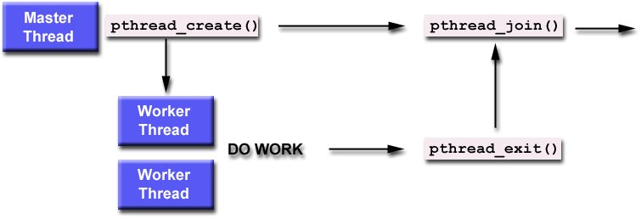
Threading lifecycle example

Slide 9
Mutexes
A thread that is busy-waiting may continually use the CPU accomplishing nothing.
Mutex (mutual exclusion) is a special type of variable that can be used to restrict access to a critical section to a single thread at a time.

Slide 10

Mutexes
Used to guarantee that one thread “excludes” all other threads while it executes the critical section.
The Pthreads standard includes a special type for mutexes: pthread_mutex_t.

Slide 11
Mutexes
When a Pthreads program finishes using a mutex, it should call
In order to gain access to a critical section a thread calls

Slide 12
Mutexes
When a thread is finished executing the code in a critical section, it should call
Nonblocking call allows for additional versatility
int pthread_mutex_trylock(pthread_mutex_t* mp);

Slide 13
Global sum function that uses a mutex
#include <pthread.h>
...
void *thread_function( void *arg )
{
int my_sum; //for local calculations
… //do computations to calculate my_sum
pthread_mutex_lock(&mutex); //wait for sum to be available to update
sum += my_sum;
pthread_mutex_unlock(&mutex); //allow others to access sum as needed
}
...
pthread_mutex_t mutex; // a global variable which threads share access to
int sum;
...
int main()
{
...
// create threads
pthread_create( &thread[i], NULL, thread_function, NULL );
... // threads work to compute sum
pthread_join( thread[i], NULL );
return 0;
}

Slide 14
Semaphores
Counting Semaphores:
permit a limited number of threads to execute a section of the code
similar to mutexes
should include the semaphore.h header file
semaphore functions do not have pthread_ prefixes; instead, they have sem_ prefixes

Slide 15
Basic Semaphore Functions
creating a semaphore:
int sem_init(sem_t *sem, int pshared, unsigned int value);
initializes a semaphore object pointed to by sem
pshared is a sharing option; a value of 0 means the semaphore is local to the calling process
gives an initial value value to the semaphore
terminating a semaphore:
int sem_destroy(sem_t *sem);
frees the resources allocated to the semaphore sem
usually called after pthread_join()
an error will occur if a semaphore is destroyed for which a thread is waiting

Slide 16
Basic Semaphore Functions
semaphore control:
int sem_post(sem_t *sem);
int sem_wait(sem_t *sem);
sem_post atomically increases the value of a semaphore by 1, i.e., when 2 threads call sem_post simultaneously, the semaphore's value will also be increased by 2 (there are 2 atoms calling)
sem_wait atomically decreases the value of a semaphore by 1; but always waits until the semaphore has a non-zero value first

Slide 17
#include <pthread.h>
#include <semaphore.h>
...
void *thread_function( void *arg );
...
sem_t semaphore; // also a global variable just like mutexes
...
int main()
{
int tmp;
...
// initialize the semaphore
tmp = sem_init( &semaphore, 0, 0 );
...
// create threads
pthread_create( &thread[i], NULL, thread_function, NULL );
...
while ( still_has_something_to_do() )
{
sem_post( &semaphore );
...
}
...
pthread_join( thread[i], NULL );
sem_destroy( &semaphore );
return 0;
}

Slide 18
void *thread_function( void *arg )
{
sem_wait( &semaphore );
perform_task_when_sem_open();
...
pthread_exit( NULL );
}
the main thread increments the semaphore's count value in the while loop
the threads wait until the semaphore's count value is non-zero before performing perform_task_when_sem_open() and further
daughter thread activities stop only when pthread_join() is called

Slide 19
Example: Multi-Threaded Linked List
Functions
Member
Insert
Delete
Implementing access mechanisms with Pthreads

Slide 20
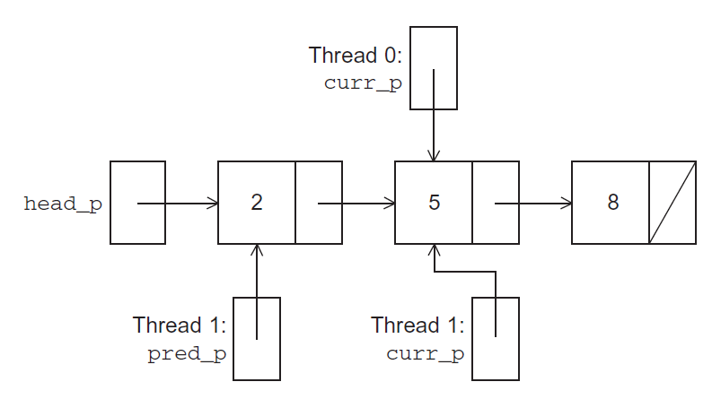
Simultaneous access by two threads

Slide 21
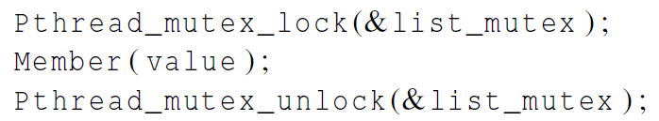
Solution #1
Lock entire list
A call to each of the three functions can be protected by a mutex.
In place of calling Member(value).

Slide 22
Issues
We’re serializing access to the list.
If the vast majority of our operations are calls to Member, we’ll fail to exploit this opportunity for parallelism.
On the other hand, if most of our operations are calls to Insert and Delete, then this may be the best solution since we’ll need to serialize access to the list for most of the operations, and this solution will certainly be easy to implement.

Slide 23
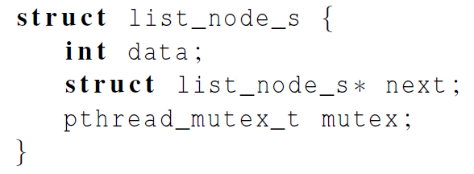
Solution #2
Instead of locking the entire list, we could try to lock individual nodes
A “finer-grained” approach

Slide 24
Issues
This is much more complex than the original Member function.
It is also much slower, since, in general, each time a node is accessed, a mutex must be locked and unlocked.
The addition of a mutex field to each node will substantially increase the amount of storage needed for the list.

Slide 25
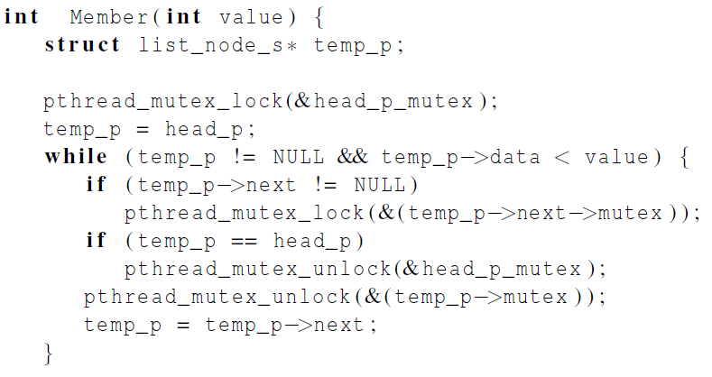
Implementation of Member with one mutex per list node (1)

Slide 26
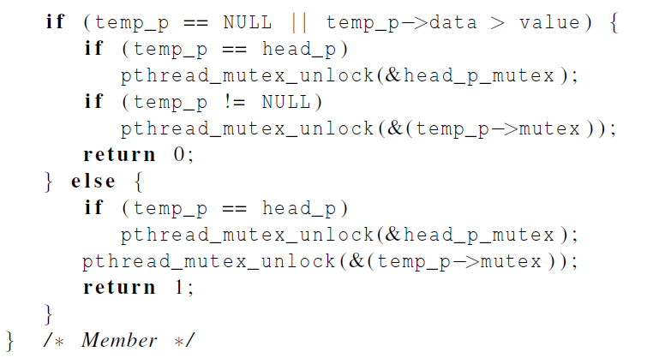
Implementation of Member with one mutex per list node (2)

Slide 27
Pthreads Read-Write Locks
Handles the Readers/Writers problem !
Provides two locking mechanisms
Allows multiple readers
Gives priority to …

Slide 28
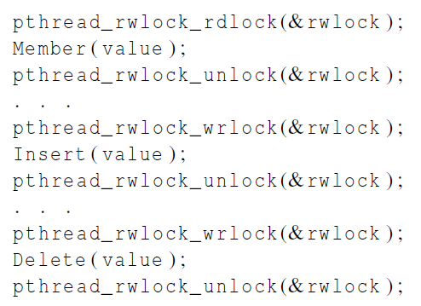
Protecting our linked list functions

Slide 29
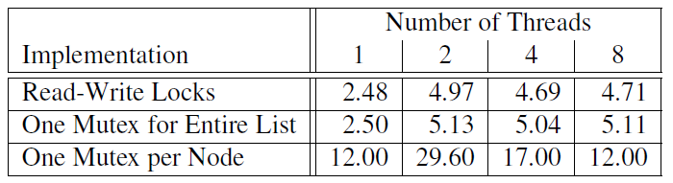
Linked List Performance
100,000 ops/thread
80% Member
10% Insert
10% Delete

Slide 30
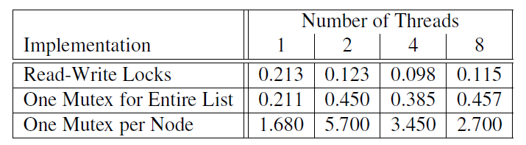
Linked List Performance
100,000 ops/thread
99.9% Member
0.05% Insert
0.05% Delete

Slide 31
Deadlock
Permanent
No efficient solution
The permanent blocking of a set of processes that either compete for system resources or communicate with each other
A set of processes is deadlocked when each process in the set is blocked awaiting an event that can only be triggered by another blocked process in the set
Notes:
Deadlock can be defined as the permanent blocking of a set of processes that either compete for system resources or communicate with each other. A set of processes is deadlocked when each process in the set is blocked awaiting an event (typically the freeing up of some requested resource) that can only be triggered by another blocked process in the set. Deadlock is permanent because none of the events is ever triggered. Unlike other problems in concurrent process management, there is no efficient solution in the general case.

Slide 32
Resource Categories
Reusable
can be safely used by only one process at a time and is not depleted by that use
processors, I/O channels, main and secondary memory, devices, and data structures such as files, databases, and semaphores
Consumable
one that can be created (produced) and destroyed (consumed)
interrupts, signals, messages, and information
in I/O buffers
Notes:
Two general categories of resources can be distinguished: reusable and consumable. A reusable resource is one that can be safely used by only one process at a time and is not depleted by that use. Processes obtain resource units that they later release for reuse by other processes. Examples of reusable resources include processors; I/O channels; main and secondary memory; devices; and data structures such as files, databases, and semaphores.
A consumable resource is one that can be created (produced) and destroyed (consumed). Examples of consumable resources are interrupts, signals, messages, and information in I/O buffers.

Slide 33
Example: Memory Request
Space is available for allocation of 200Kbytes, and the following sequence of events occur:
Deadlock occurs if both processes progress to their second request
P1
P2
. . .
. . .
Request 80 Kbytes;
Request 70 Kbytes;
. . .
. . .
Request 60 Kbytes;
Request 80 Kbytes;
Notes:
Another example of deadlock with a reusable resource has to do with requests for main memory. Suppose the space available for allocation is 200 Kbytes, and the following sequence of requests occurs: (see diagram)
Deadlock occurs if both processes progress to their second request. If the amount of memory to be requested is not known ahead of time, it is difficult to deal with this type of deadlock by means of system design constraints. The best way to deal with this particular problem is, in effect, to eliminate the possibility by using virtual memory, which is discussed in Chapter 8 .

Slide 34
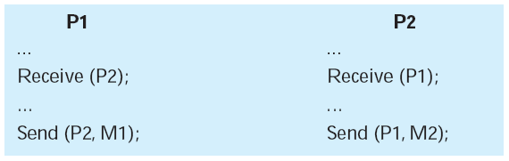
Consumable Resources Deadlock
Consider a pair of processes, in which each process attempts to receive a message from the other process and then send a message to the other process:
Deadlock occurs if the Receive is blocking
Notes:
As an example of deadlock involving consumable resources, consider the following pair of processes, in which each process attempts to receive a message
from the other process and then send a message to the other process: (see diagram)
Deadlock occurs if the Receive is blocking (i.e., the receiving process is blocked until the message is received). Once again, a design error is the cause of the deadlock. Such errors may be quite subtle and difficult to detect. Furthermore, it may take a rare combination of events to cause the deadlock; thus a program could be in use for a considerable period of time, even years, before the deadlock actually occurs.

Slide 35
Deadlock conditions don’t necessarily have to result in deadlock…
Notes:
All deadlocks involve conflicting needs for resources by two or more processes. A common example is the traffic deadlock. Figure 6.1a shows a situation in which four cars have arrived at a four-way stop intersection at approximately the same time. The four quadrants of the intersection are the resources over which control is needed. In particular, if all four cars wish to go straight through the intersection, the resource requirements are as follows:
• Car 1, traveling north, needs quadrants a and b.
• Car 2 needs quadrants b and c.
• Car 3 needs quadrants c and d.
• Car 4 needs quadrants d and a.
The rule of the road in the United States is that a car at a four-way stop should defer to a car immediately to its right. This rule works if there are only two or three cars at the intersection. For example, if only the northbound and westbound cars arrive at the intersection, the northbound car will wait and the westbound car proceeds. However, if all four cars arrive at about the same time, each will refrain from entering the intersection, this causes a potential deadlock. The deadlock is only potential, not actual, because the necessary resources are available for any of the cars to proceed. If one car eventually does proceed, it can do so.
However, if all four cars ignore the rules and proceed (cautiously) into the
intersection at the same time, then each car seizes one resource (one quadrant) but
cannot proceed because the required second resource has already been seized by
another car. This is an actual deadlock.

Slide 36
Notes:
Let us now look at a depiction of deadlock involving processes and computer resources. Figure 6.2 (based on one in [BACO03]), which we refer to as a joint progress diagram , illustrates the progress of two processes competing for two resources. Each process needs exclusive use of both resources for a certain period of time.
In Figure 6.2 , the x -axis represents progress in the execution of P and the y –axis represents progress in the execution of Q. The joint progress of the two processes is therefore represented by a path that progresses from the origin in a northeasterly direction. For a uniprocessor system, only one process at a time may execute, and the path consists of alternating horizontal and vertical segments, with a horizontal segment representing a period when P executes and Q waits and a vertical segment representing a period when Q executes and P waits. The figure indicates areas in which both P and Q require resource A (upward slanted lines); both P and Q require resource B (downward slanted lines); and both P and Q require both resources. Because we assume that each process requires exclusive control of any resource, these are all forbidden regions; that is, it is impossible for any path representing the
joint execution progress of P and Q to enter these regions.
The figure shows six different execution paths. These can be summarized as
follows:
1. Q acquires B and then A and then releases B and A. When P resumes execution,
it will be able to acquire both resources.
2. Q acquires B and then A. P executes and blocks on a request for A. Q releases
B and A. When P resumes execution, it will be able to acquire both resources.
3. Q acquires B and then P acquires A. Deadlock is inevitable, because as execution
proceeds, Q will block on A and P will block on B.
4. P acquires A and then Q acquires B. Deadlock is inevitable, because as execution
proceeds, Q will block on A and P will block on B.
5. P acquires A and then B. Q executes and blocks on a request for B. P releases
A and B. When Q resumes execution, it will be able to acquire both resources.
6. P acquires A and then B and then releases A and B. When Q resumes execution,
it will be able to acquire both resources.
The gray-shaded area of Figure 6.2 , which can be referred to as a fatal region , applies to the commentary on paths 3 and 4. If an execution path enters this fatal region, then deadlock is inevitable. Note that the existence of a fatal region depends on the logic of the two processes. However, deadlock is only inevitable if the joint progress of the two processes creates a path that enters the fatal region.

Slide 37
Notes:
Whether or not deadlock occurs depends on both the dynamics of the execution and on the details of the application.
This situation is reflected in Figure 6.3 . Some thought should convince you that regardless of the relative timing of the two processes, deadlock cannot occur.
As shown, the joint progress diagram can be used to record the execution history of two processes that share resources. In cases where more than two processes may compete for the same resource, a higher-dimensional diagram would be required. The principles concerning fatal regions and deadlock would remain the same.

Slide 38
Conditions for Deadlock
Mutual Exclusion
only one process may use a resource at a time
Hold-and-Wait
a process may hold allocated resources while awaiting assignment of others
No Pre-emption
no resource can be forcibly removed from a process holding it
Circular Wait
a closed chain of processes exists, such that each process holds at least one resource needed by the next process in the chain
Notes:
Three conditions of policy must be present for a deadlock to be possible:
1. Mutual exclusion . Only one process may use a resource at a time. No process may access a resource unit that has been allocated to another process.
2. Hold and wait . A process may hold allocated resources while awaiting assignment of other resources.
3. No preemption . No resource can be forcibly removed from a process holding it.
In many ways these conditions are quite desirable. For example, mutual exclusion is needed to ensure consistency of results and the integrity of a database. Similarly, preemption should not be done arbitrarily. For example, when data resources are involved, preemption must be supported by a rollback recovery mechanism, which restores a process and its resources to a suitable previous state from which the process can eventually repeat its actions.
The first three conditions are necessary but not sufficient for a deadlock to exist. For deadlock to actually take place, a fourth condition is required:
4. Circular wait . A closed chain of processes exists, such that each process holds at least one resource needed by the next process in the chain (e.g., Figure 6.5c
and Figure 6.6 ).
The fourth condition is, actually, a potential consequence of the first three. That is, given that the first three conditions exist, a sequence of events may occur that lead to an unresolvable circular wait. The unresolvable circular wait is in fact the definition of deadlock. The circular wait listed as condition 4 is unresolvable because the first three conditions hold. Thus, the four conditions, taken together, constitute necessary and sufficient conditions for deadlock.

Slide 39
Notes:
A useful tool in characterizing the allocation of resources to processes is the resource allocation graph , introduced by Holt [HOLT72]. The resource allocation graph is a directed graph that depicts a state of the system of resources and processes, with each process and each resource represented by a node. A graph edge directed from a process to a resource indicates a resource that has been requested by the process but not yet granted ( Figure 6.5a ). Within a resource node, a dot is shown for each instance of that resource. Examples of resource types that may have multiple instances are I/O devices that are allocated by a resource management module in the OS. A graph edge directed from a reusable resource node dot to a process indicates a request that has been granted ( Figure 6.5b ); that is, the process has been assigned one unit of that resource. A graph edge directed from a consumable
resource node dot to a process indicates that the process is the producer of that
resource.
Figure 6.5c shows an example deadlock. There is only one unit each of resources Ra and Rb. Process P1 holds Rb and requests Ra, while P2 holds Ra but requests Rb. Figure 6.5d has the same topology as Figure 6.5c , but there is no deadlock because multiple units of each resource are available.

Slide 40
Notes:
The resource allocation graph of Figure 6.6 corresponds to the deadlock situation in Figure 6.1b . Note that in this case, we do not have a simple situation in which two processes each have one resource the other needs. Rather, in this case, there is a circular chain of processes and resources that results in deadlock.

Slide 41
Dealing with Deadlock
Three general approaches exist for dealing with deadlock:
Prevent Deadlock
adopt a policy that eliminates one of the conditions
Avoid Deadlock
make the appropriate dynamic choices based on the current state of resource allocation
Detect Deadlock
attempt to detect the presence of deadlock and take action to recover
Notes:
Three general approaches exist for dealing with deadlock. First, one can prevent deadlock by adopting a policy that eliminates one of the conditions (conditions 1 through 4). Second, one can avoid deadlock by making the appropriate dynamic choices based on the current state of resource allocation. Third, one can attempt to detect the presence of deadlock (conditions 1 through 4 hold) and take action to recover.

Slide 42
Deadlock Prevention Strategies
Direct
Indirect
Prevent the occurrence of a circular wait
Prevent the occurrence of one of the three necessary conditions
Mutual Exclusion
Hold-and-Wait
No Preemption

Slide 43
Preventing…
Mutual Exclusion
Generally have to provide
Hold and Wait
Could require simultaneous resource allocation
A Priori knowledge
Might not need everything simultaneously
Long wait times?
No Preemption
If a process holding resources hits a denial, release resources
Must account for some sort of rollback
Circular Wait
Order resources, can only be requested in order

Slide 44
Deadlock Avoidance
A decision is made dynamically whether the current resource allocation request will, if granted, potentially lead to a deadlock
Requires knowledge of future process requests
Deadlock Avoidance
Process Initiation Denial
Resource Allocation Denial
do not start a process if its demands might lead to deadlock
do not grant an incremental resource request to a process if this allocation might lead to deadlock
Notes:
An approach to solving the deadlock problem that differs subtly from deadlock prevention is deadlock avoidance. In deadlock prevention , we constrain resource requests to prevent at least one of the four conditions of deadlock. This is either done indirectly, by preventing one of the three necessary policy conditions (mutual exclusion, hold and wait, no preemption), or directly, by preventing circular wait. This leads to inefficient use of resources and inefficient execution of processes. Deadlock avoidance , on the other hand, allows the three necessary conditions but makes judicious choices to assure that the deadlock point is never reached. As such, avoidance allows more concurrency than prevention. With deadlock avoidance, a decision is made dynamically whether the current resource allocation request will, if granted, potentially lead to a deadlock. Deadlock avoidance thus requires knowledge
of future process resource requests.

Slide 45
Deadlock Avoidance
Can be structured mathematically
Resource Vector (total resources)
Available Vector (unused resources)
Claim Matrix (resources required)
Allocation Matrix (resources in use)
NOT an all-or-nothing allocation

Slide 46

Resource Allocation Denial
Referred to as the banker’s algorithm
State of the system reflects the current allocation of resources to processes
Safe state is one in which there is at least one sequence of resource allocations to processes that does not result in a deadlock
Unsafe state is a state that is not safe
Notes:
The strategy of resource allocation denial, referred to as the banker’s algorithm, was first proposed in [DIJK65]. Let us begin by defining the concepts of state and safe state. Consider a system with a fixed number of processes and a fixed number of resources. At any time a process may have zero or more resources allocated to it. The state of the system reflects the current allocation of resources to processes. Thus, the state consists of the two vectors, Resource and Available, and the two matrices, Claim and Allocation, defined earlier. A safe state is one in which there is at least one sequence of resource allocations to processes that does not result in a deadlock (i.e., all of the processes can be run to completion). An unsafe state is, of course, a state that is not safe.

Slide 47
Can any of the four processes be run to completion with the resources available?
That is, can the difference between the maximum requirement and current
allocation for any process be met with the available resources?
Figure 6.7 Determination of a Safe State
Notes:
The following example illustrates these concepts. Figure 6.7a shows the state of a system consisting of four processes and three resources. The total amount of resources R1, R2, and R3 are 9, 3, and 6 units, respectively. In the current state allocations have been made to the four processes, leaving 1 unit of R2 and 1 unit of R3 available. Is this a safe state? To answer this question, we ask an intermediate question: Can any of the four processes be run to completion with the resources available? That is, can the difference between the maximum requirement and current allocation for any process be met with the available resources? In terms of the matrices and vectors introduced earlier, the condition to be met
for process i is:
C_{ij} - A_{ij} … V_{j}, for all j

Slide 48
Process 2 has finished running, returning resources to the available vector.
What are the possible safe state(s) from here?
Figure 6.7 Determination of a Safe State
Notes:
Clearly, this is not possible for P1, which has only 1 unit of R1 and requires 2 more units of R1, 2 units of R2, and 2 units of R3. However, by assigning one unit of R3 to process P2, P2 has its maximum required resources allocated and can run to completion. Let us assume that this is accomplished. When P2 completes, its resources can be returned to the pool of available resources. The resulting state is shown in Figure 6.7b . Now we can ask again if any of the remaining processes can be completed. In this case, each of the remaining processes could be completed.

Slide 49
Process 1 was allocated resources and has finished running,
returning resources to the available vector.
What process(es) are denied resources from here?
Figure 6.7 Determination of a Safe State
Notes:
Suppose we choose P1, allocate the required resources, complete P1, and return all of P1’s resources to the available pool. We are left in the state shown in Figure 6.7c .

Slide 50
Unsafe state … ?
What if P1 only makes a request to obtain 1 R1 and 1 R3? …

Slide 51
If P1 was given the additional R1 and R3, no process
could complete, so the resources should not be provided
Figure 6.8 Determination of an Unsafe State
Notes:
Consider the state defined in Figure 6.8a . Suppose P2 makes a request for one additional unit of R1 and one additional unit of R3. If we assume the request is granted, then the resulting state is that of Figure 6.7a . We have already seen that this is a safe state; therefore, it is safe to grant the request. Now let us return to the state of Figure 6.8a and suppose that P1 makes the request for one additional unit each of R1 and R3; if we assume that the request is granted, we are left in the state of Figure 6.8b . Is this a safe state? The answer is no, because each process will need at least one additional unit of R1, and there are none available. Thus, on the basis of deadlock avoidance, the request by P1 should be denied and P1 should be blocked.
It is important to point out that Figure 6.8b is not a deadlocked state. It merely has the potential for deadlock. It is possible, for example, that if P1 were run from this state it would subsequently release one unit of R1 and one unit of R3 prior to needing these resources again. If that happened, the system would return to a safe state. Thus, the deadlock avoidance strategy does not predict deadlock with certainty; it merely anticipates the possibility of deadlock and assures that there is never such a possibility.

Slide 52
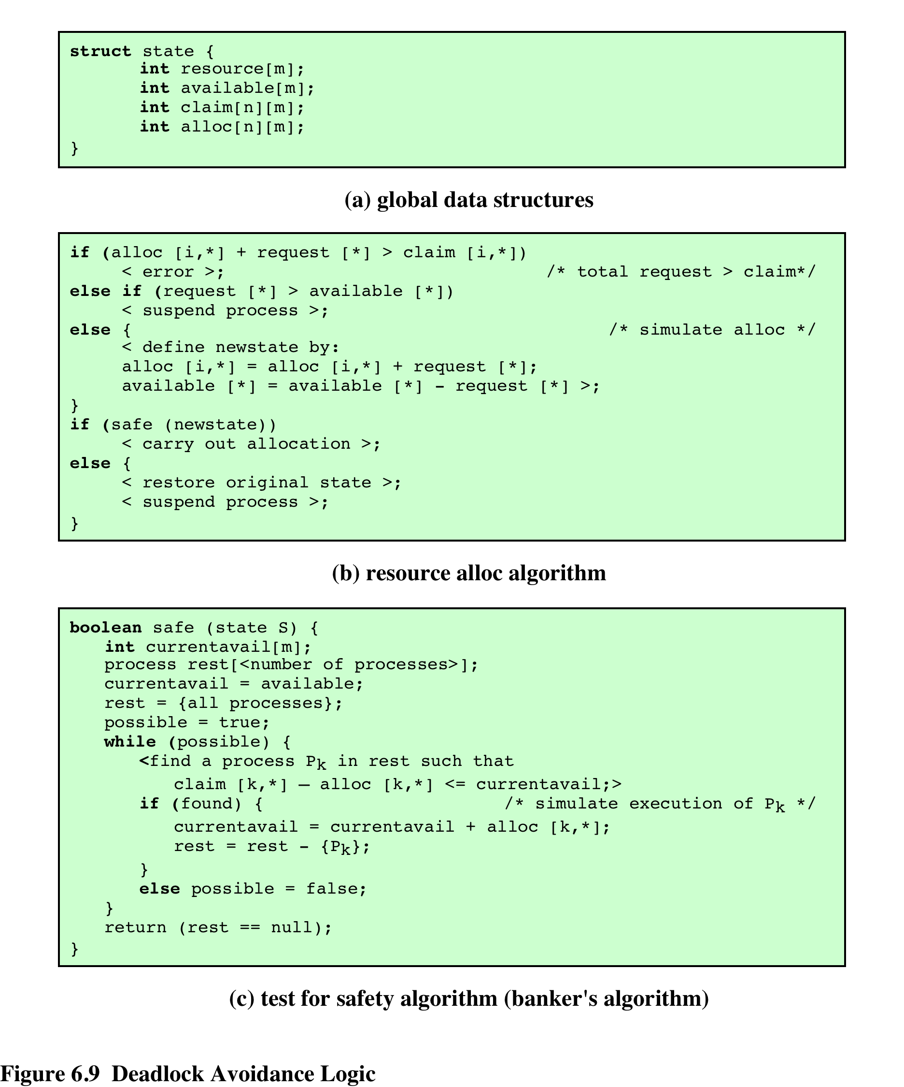
Figure 6.9
Deadlock Avoidance Logic
Notes:
Figure 6.9 gives an abstract version of the deadlock avoidance logic. The main algorithm is shown in part (b). With the state of the system defined by the data structure state , request[*] is a vector defining the resources requested by process i . First, a check is made to assure that the request does not exceed the original claim of the process. If the request is valid, the next step is to determine if it is possible to fulfill the request (i.e., there are sufficient resources available). If it is not possible, then the process is suspended. If it is possible, the final step is to
determine if it is safe to fulfill the request. To do this, the resources are tentatively assigned to process i to form newstate .
Then a test for safety is made using the algorithm in Figure 6.9c.

Slide 53
Deadlock Avoidance
Advantages
It is not necessary to preempt and rollback processes, as in deadlock detection
It is less restrictive than deadlock prevention
Restrictions
Still have to know the resources requested in advance
Processes must be independent
No process may exit while holding resources

Slide 54
Deadlock Detection
Resource Vector (total resources)
Allocation Matrix (currently allocated)
Request Matrix (still needed)
Available Matrix (unused resources)
Available = resource – sum(allocation column)
Algorithm

Slide 55
Notes:
We can use Figure 6.10 to illustrate the deadlock detection algorithm. The
algorithm proceeds as follows:
1. Mark P4, because P4 has no allocated resources.
2. Set W = (0 0 0 0 1).
3. The request of process P3 is less than or equal to W, so mark P3 and set W=W + (0 0 0 1 0) = (0 0 0 1 1).
4. No other unmarked process has a row in Q that is less than or equal to W.
Therefore, terminate the algorithm.
The algorithm concludes with P1 and P2 unmarked, indicating that these processes are deadlocked.

Slide 56
Deadlock Recovery Options
Abort all deadlocked processes
Back up each deadlocked process to some previously defined checkpoint and restart all processes
Successively abort deadlocked processes until deadlock no longer exists
Successively preempt resources until deadlock no longer exists

Slide 57
Table 6.1
Summary of Deadlock Detection, Prevention, and Avoidance
Approaches for Operating Systems [ISLO80]
Notes:
As Table 6.1 suggests, there are strengths and weaknesses to all of the strategies for dealing with deadlock. Rather than attempting to design an OS facility that employs only one of these strategies, it might be more efficient to use different strategies in different situations.

Slide 58
Integrated Deadlock Strategy
Incorporate different mechanisms for different situations
Swappable Space (on secondary storage)
Require upfront allocation of all resources
No “hold and wait”
Main memory
Allow Preemption
Internal Resources (I/O channels)
Resource ordering

Slide 59
UNIX Concurrency Mechanisms
UNIX provides a variety of mechanisms for interprocessor communication and synchronization including:
Pipes
Messages
Shared memory
Semaphores
Signals
Notes:
UNIX provides a variety of mechanisms for interprocessor communication and synchronization.
Here, we look at the most important of these:
• Pipes
• Messages
• Shared memory
• Semaphores
• Signals
Pipes, messages, and shared memory can be used to communicate data between
processes, whereas semaphores and signals are used to trigger actions by other
processes.

Slide 60
Pipes
Circular buffers allowing two processes to communicate on the producer-consumer model
first-in-first-out queue, written by one process and read by another
Two types:
Named
Unnamed
ls –al | less
Notes:
One of the most significant contributions of UNIX to the development of operating systems is the pipe. Inspired by the concept of coroutines [RITC84], a pipe is a circular buffer allowing two processes to communicate on the producer–consumer model. Thus, it is a first-in-first-out queue, written by one process and read by another.
When a pipe is created, it is given a fixed size in bytes. When a process attempts to write into the pipe, the write request is immediately executed if there is sufficient room; otherwise the process is blocked. Similarly, a reading process is blocked if it attempts to read more bytes than are currently in the pipe; otherwise the read request is immediately executed. The OS enforces mutual exclusion: that is, only one process can access a pipe at a time.
There are two types of pipes: named and unnamed. Only related processes can share unnamed pipes, while either related or unrelated processes can share named pipes.

Slide 61
Named Pipe
mkfifo myPipe
Run from two different terminals
ls –l > myPipe
cat < myPipe
Named Pipes not allowed on MST’s campus
echo -n x | cat - pipe1 > pipe2 &
cat pipe2 > pipe1

Slide 62
Signals
A software mechanism that informs a process of the occurrence of asynchronous events
similar to a hardware interrupt, but does not employ priorities
A signal is delivered by updating a field in the process table for the process to which the signal is being sent
A process may respond to a signal by:
performing some default action
executing a signal-handler function
ignoring the signal
Notes:
A signal is a software mechanism that informs a process of the occurrence of asynchronous events. A signal is similar to a hardware interrupt but does not employ priorities. That is, all signals are treated equally; signals that occur at the same time are presented to a process one at a time, with no particular ordering.
Processes may send each other signals, or the kernel may send signals internally. A signal is delivered by updating a field in the process table for the process to which the signal is being sent. Because each signal is maintained as a single bit, signals of a given type cannot be queued. A signal is processed just after a process wakes up to run or whenever the process is preparing to return from a system call. A process may respond to a signal by performing some default action (e.g., termination), executing a signal-handler function, or ignoring the signal.

Slide 63
Table 6.2
UNIX Signals
(Table can be found on page 286 in textbook)
Notes:
Table 6.2 lists signals defined for UNIX SVR4.

Slide 64
